Slide 1
Video Pose Recognition via bidirectional deep learning
Team #1:
Deren Lei, Undergraduate, Computer Science
Zichen Sun, Undergraduate, Computer Science

Slide 2
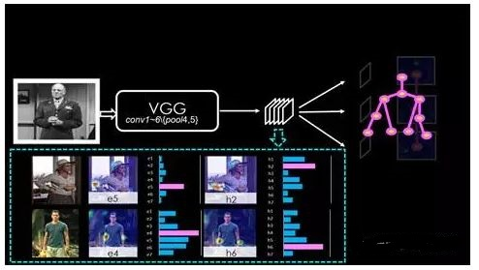
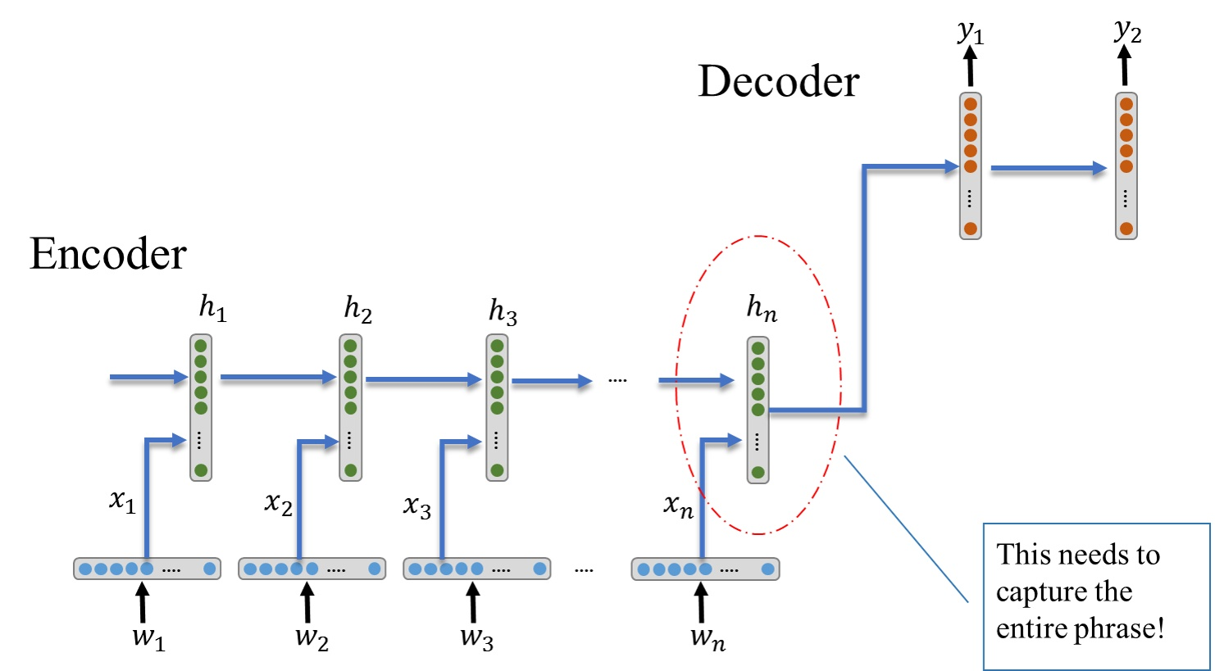
Problem Definition, Datasets, Previous Work
Goal:
To localize human actions in space and time.
Which is to identify these subjects and actions over continuous 15-minute video clips extracted from movies.
Datasets:
Google’s AVA v2.1
Solution:
Feature extraction : Convert image features to text :
CNN (VGG) Bidirectional LSTM with encoder and decoder

Slide 3
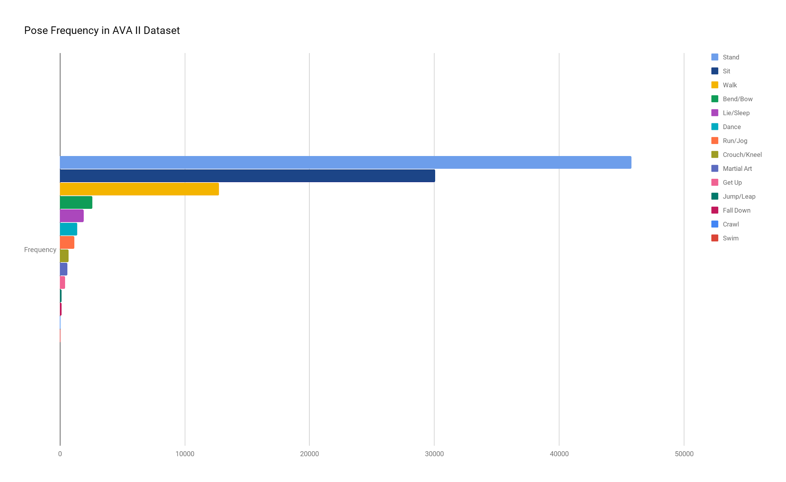
Sit->Stand->walk
Sit->Sit->Sit
Sit->Stand->Run

